Slide 1
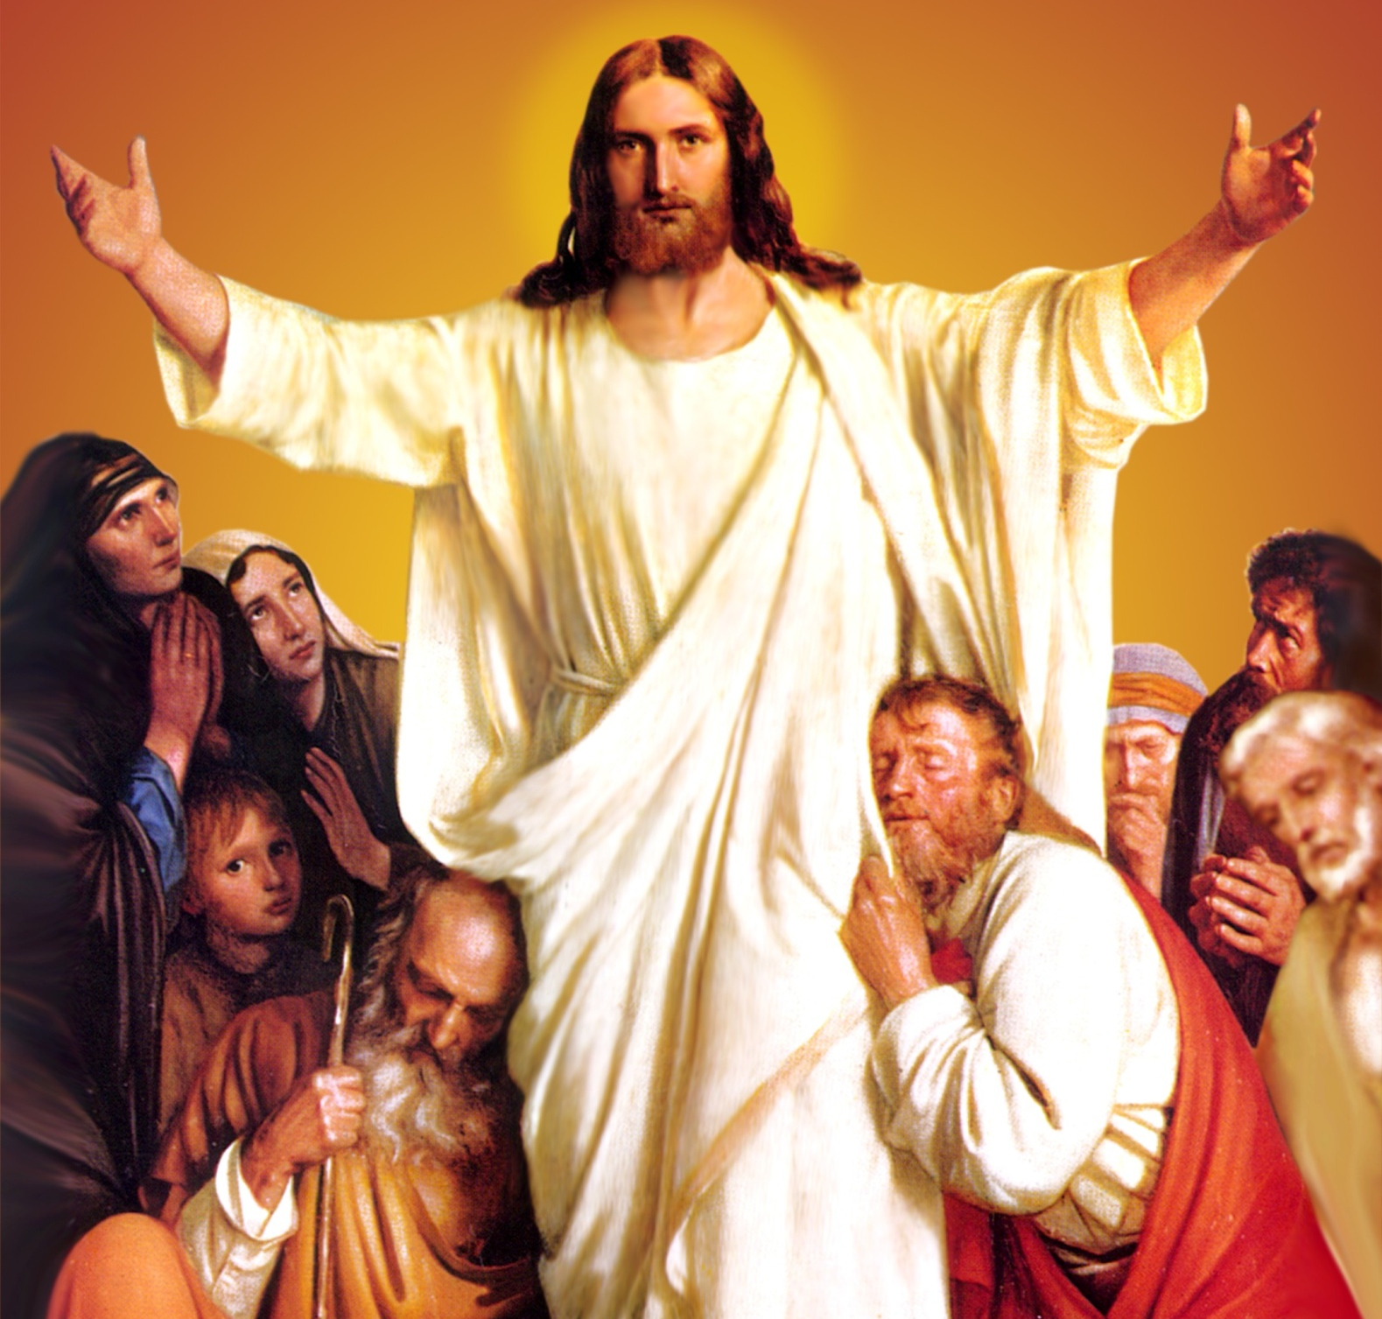
CATECHETICAL TEXTBOOK SERIES OF THE SYRO - MALABAR CHURCH
ON THE PATH OF SALVATION - 6
PEOPLE WHO
EXPERIENCED JESUS
6

Slide 2
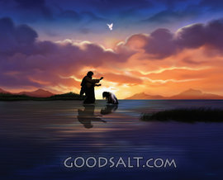
LESSON 2
THE LAMB OF GOD WHO TAKES AWAY THE SINS OF THE WORLD

Slide 3
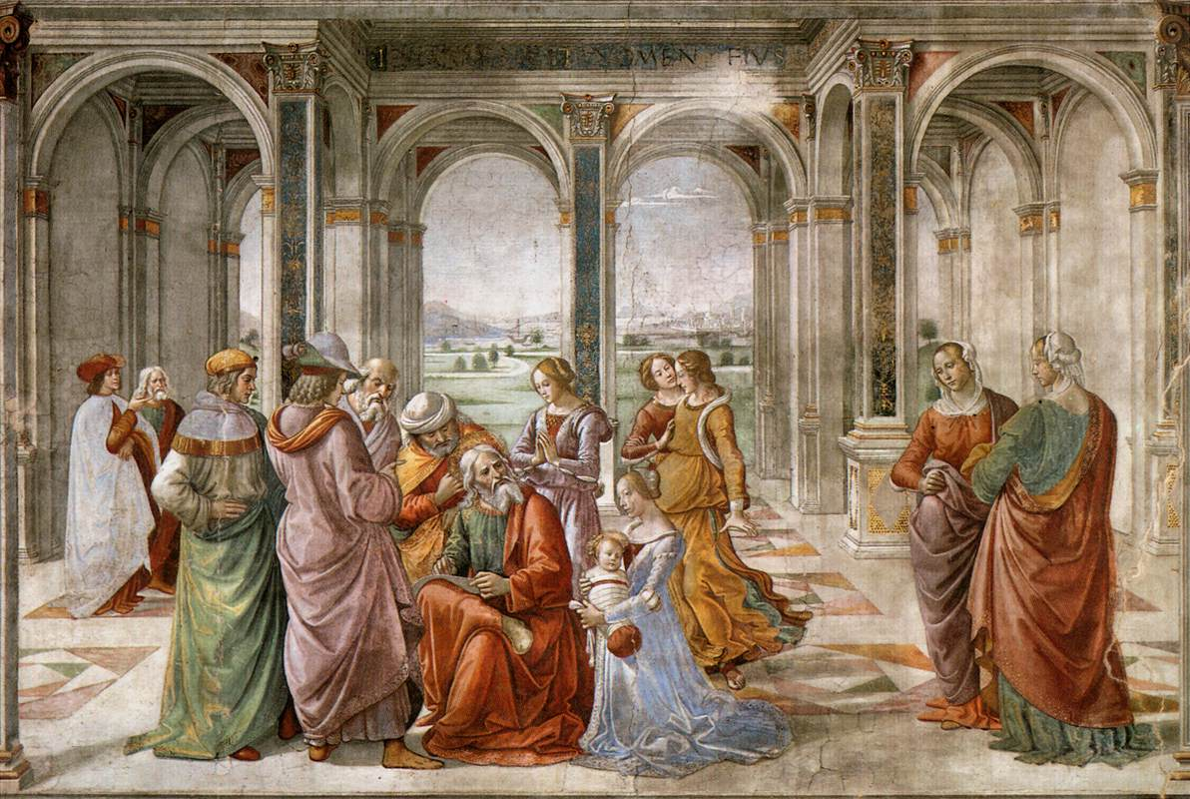
JOHN THE BAPTIST
John the Baptist was the son of Zacharias and Elisabeth, a cousin of Mary the mother of Jesus. John was called by God and sent to prepare the people to receive the Saviour Jesus Christ.

Slide 4
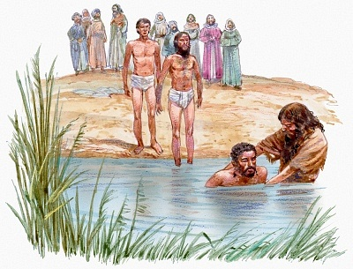
John the Baptist was giving the baptism of repentance on the bank of River Jordan.

Slide 5
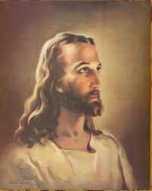
BAPTISM OF JESUS
The son of God without blemish of sin , wants to baptize from John

Slide 6
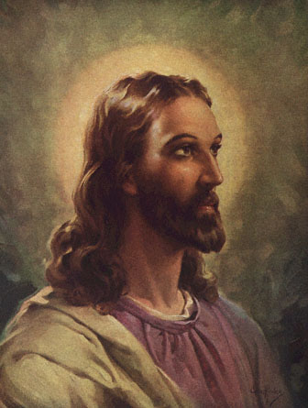
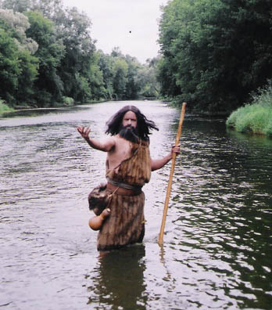
“ I need to be baptized by you, and do you come to me”?
Let it be so now; for it is proper for us in this way to fulfill all righteousness”

Slide 7
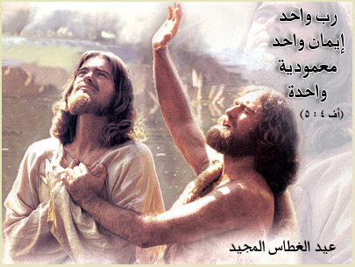
When Jesus had been baptized, just as he came up from the water, the heavens were opened to him .

Slide 8
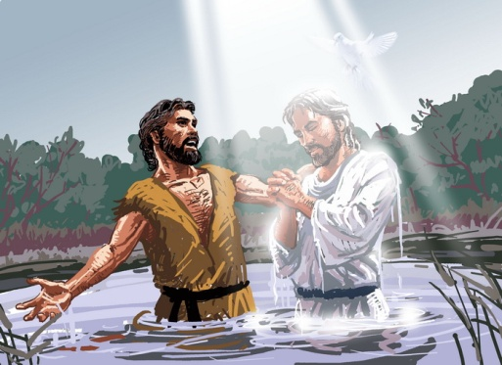
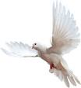
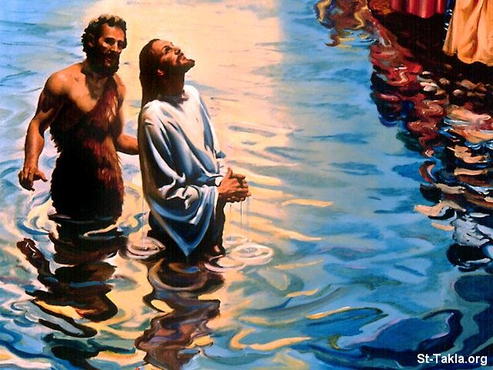
The heavens were opened and he saw the Spirit of God descending like a dove and alighting on him. A voice from heaven said
This is my son, the beloved, with whom I am well pleased” (Mt.3:13-17)

Slide 9
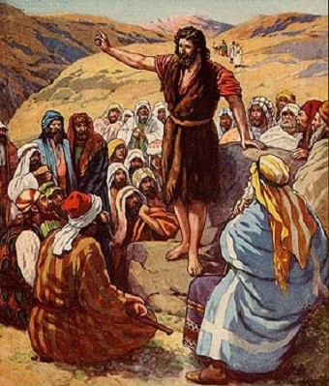
WITNESS OF JOHN
“Here is the lamb of God who takes away the sin of the world! This is he of whom I said, `After me comes a man who ranks ahead of me because he was before me.’ I myself did not know him; but I came baptizing with water for this reason, that he might be revealed to Israel.”

Slide 10
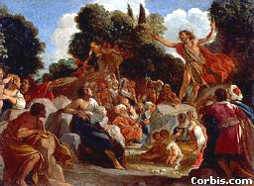
JOHN TESTIFIED
“ I saw the Spirit descending from heaven like a dove, and it remained on him. I myself did not know him, but the one who sent me to baptize with water said to me, He on whom you see the Spirit descend and remain is the one who baptizes with Holy Spirit.’ And I myself have seen and testified that this is the Son of God’.

Slide 11
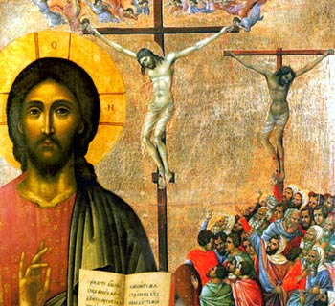
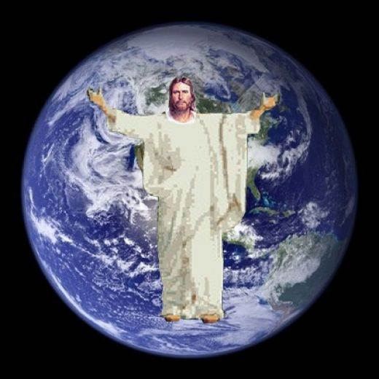
Baptism of Jesus points the sacrifice he was to offer on Calvary in atonement for the sins of mankind, and his glorious resurrection.

Slide 12
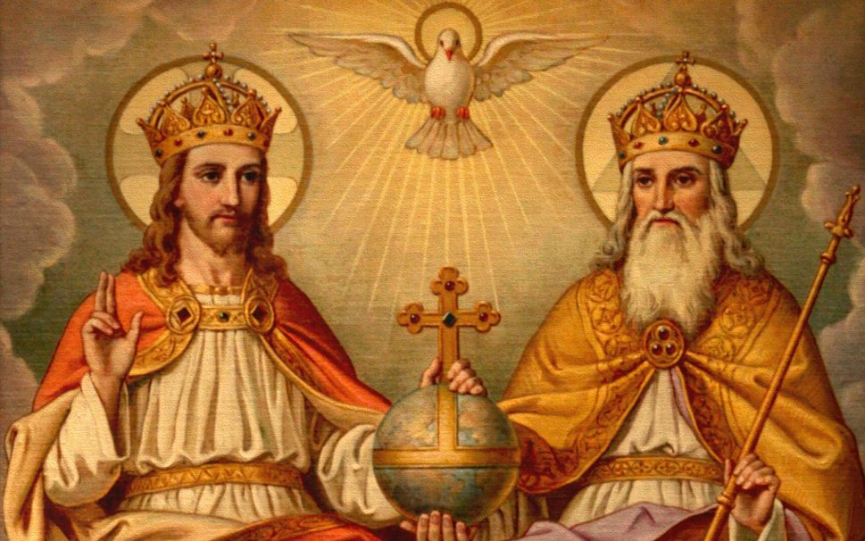
HOLY TRINITY

Slide 13
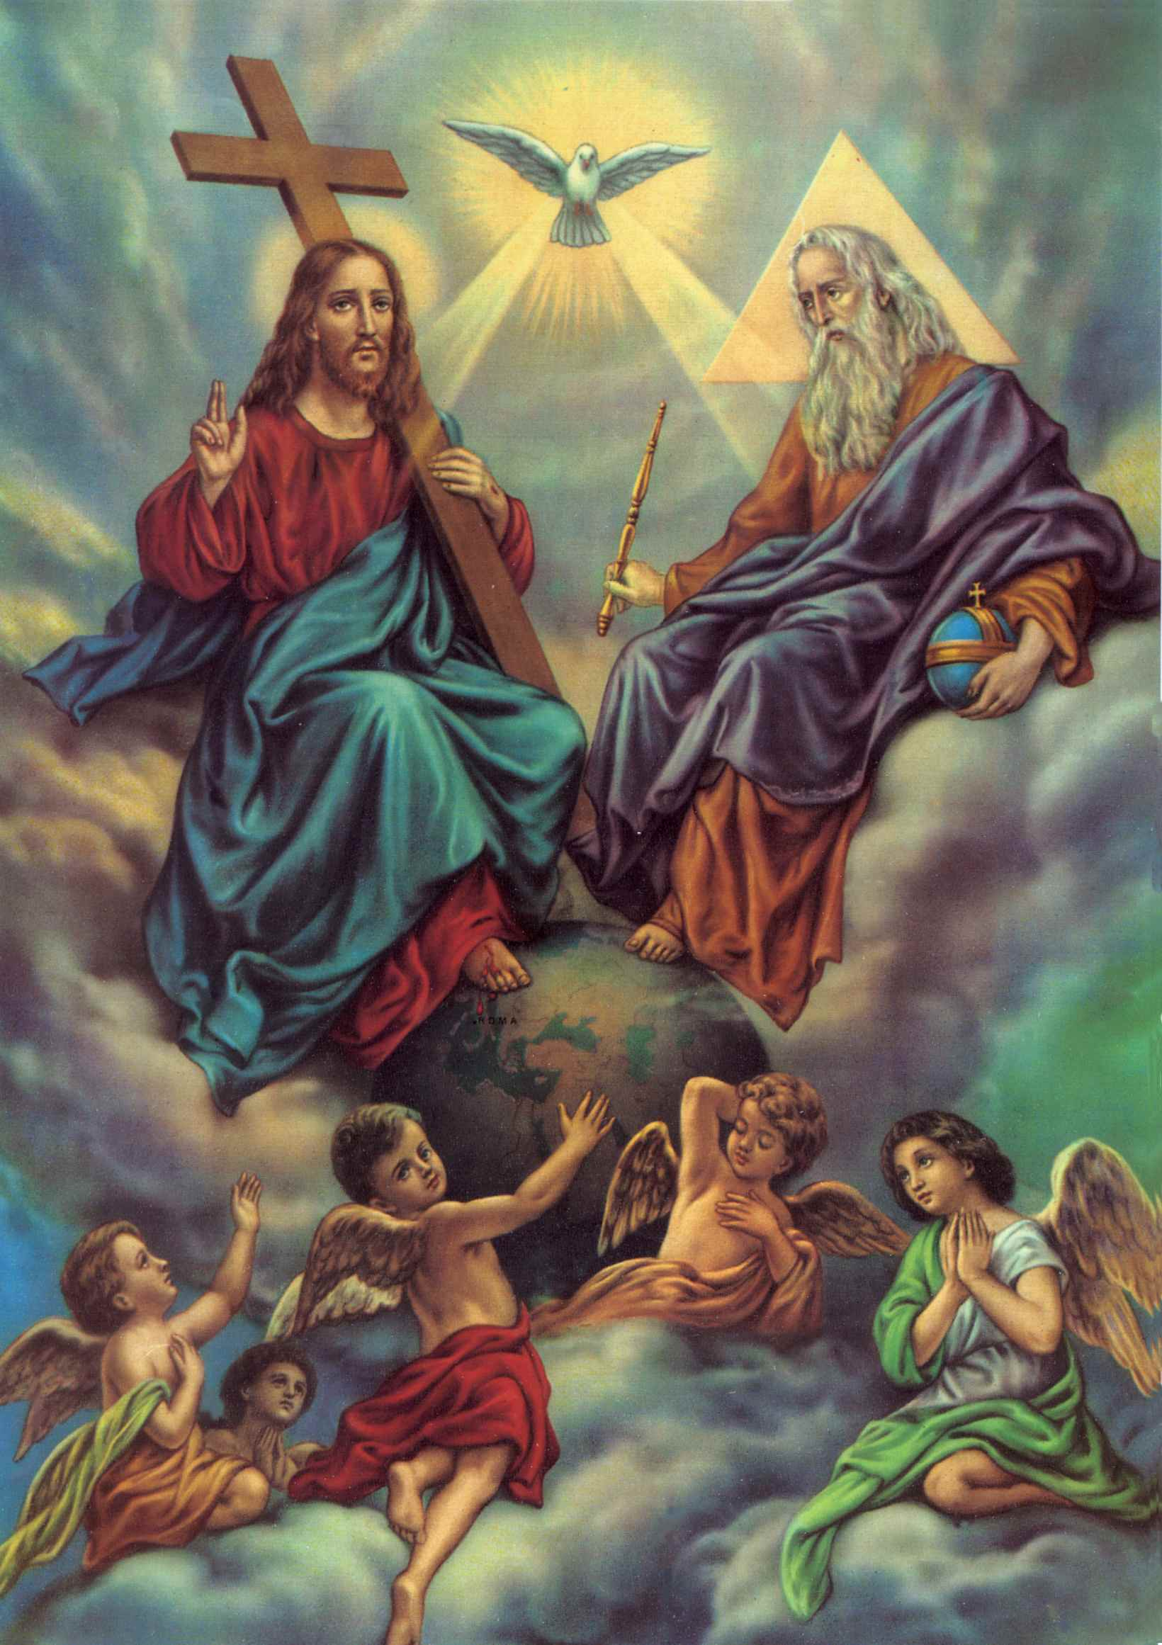
DURING THE BAPTISM OF JESUS THE MYSTERY OF THE HOLY TRINITY WAS REVEALED. GOD THE SON WAS THERE TO BE BAPTIZED. GOD THE FATHER WAS PLEASED IN HIS SON AND DECLARED ALOUD THAT THIS WAS HIS BELOVED SON.

Slide 14

The word `Christ’ means `the anointed’.
The mystery of the Holy trinity is the centre of our faith and our life.
It works in our creation, salvation as well as sanctification.

Slide 15
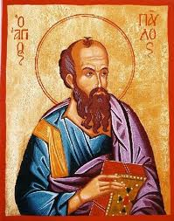
ST. PAUL GREETS
The grace of our Lord Jesus Christ, the love of God the Father and the fellowship of the Holy spirit be with you all” (2 Cor. 13:13).

Slide 16
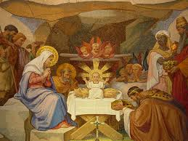
THE FEAST OF EPIPHANY
( DENEHA)
THE BAPTISM OF OUR LORD
JANUARY 6TH
In malayalam, this feast is also known as Rakkulipperunnal or Pindikuthipperunnal.

Slide 17
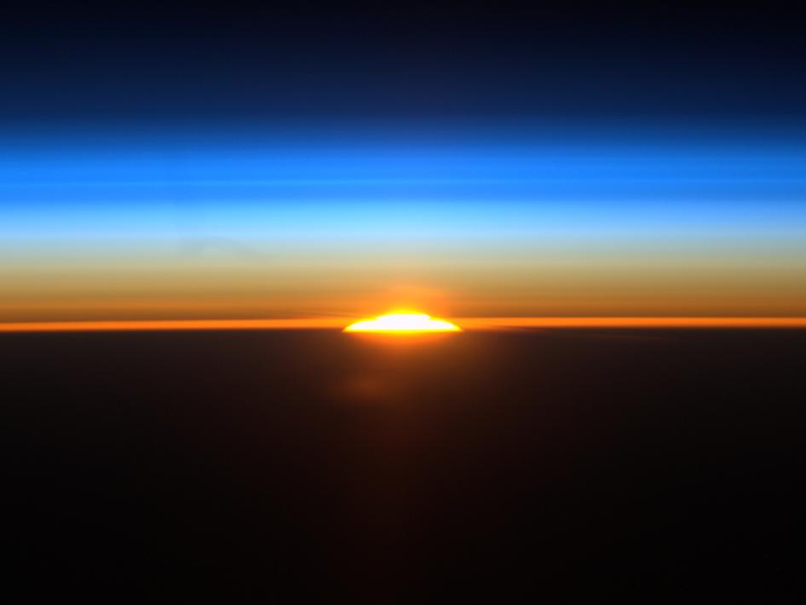
DENEHA PERIOD
THIS IS THE THIRD SEASON.
DENEHA MEANS SUNRISE OR REVELATION.

Slide 18
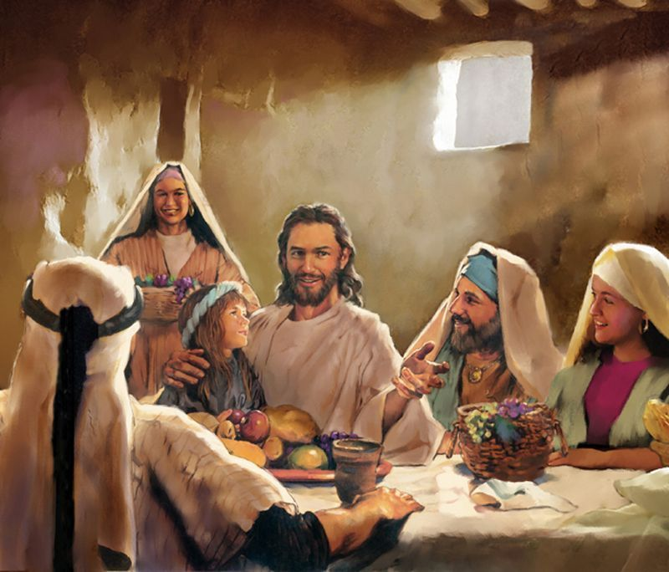
We remember and celebrate
The Holy Trinity
Jesus being the Son of God
The divine nature of Jesus
The human nature of Jesus.
His Self Sanctification
The public life of Jesus

Slide 19
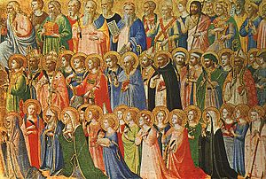
The Church celebrated feasts of Saints on Fridays of the Deneha Period.

Slide 20
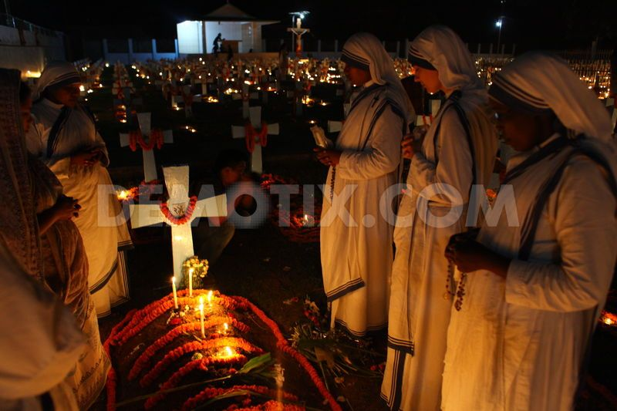
The last Friday of the Deneha Season is dedicated to the memory of `all soul’s.

Slide 21

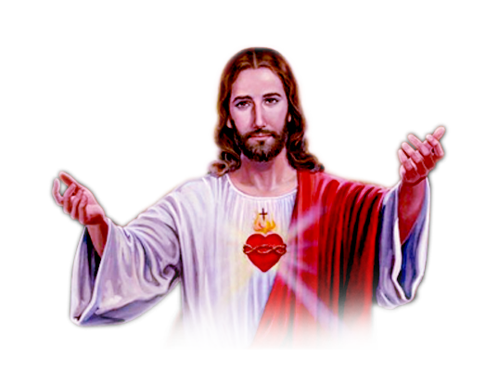
J E S U S the

Slide 22
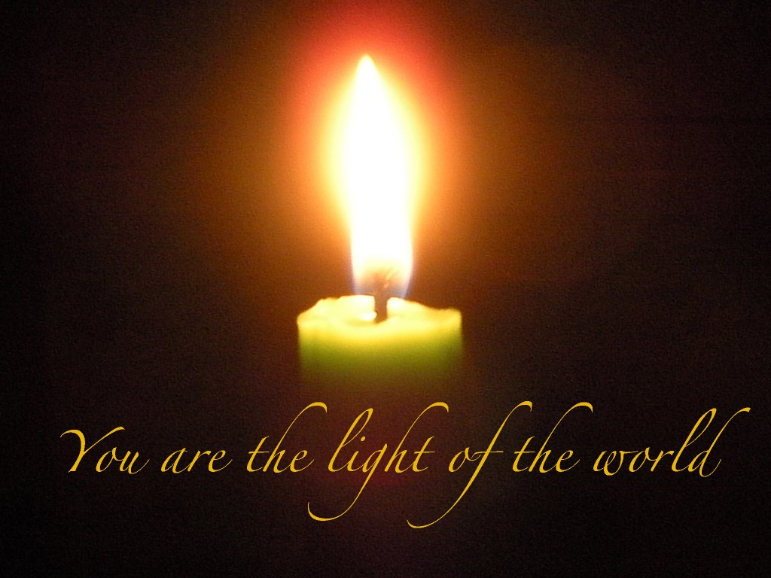
Jesus as the light that cannot be overcome by darkness (Jn.1:5-9).
`The People who live in darkness saw a great light’ was fulfilled in Jesus (Mt. 4:16).

Slide 23

In the Syro-Malabar Church there was the tradition of decorating cores of banana plants (Pindi) with lights and singing El-payya (God is light) in the procession around the decorated lights of the feast of Deneha to remember Jesus, the light of the world. The feast of Deneha was called as pindikutthipperunnaal.
Our forefathers used to have ritual baths in selected ponds or pools on the feast of Deneha, to commemorate the baptism of Jesus. So Deneha was also known as Raakkulipperunnaal.

Slide 24
John the Baptist who recognized the Son of God, called Jesus `the lamp of God that takes away the sins of the world.’ Let us experience, adore and proclaim Jesus as the strength and light of our life.

Slide 25
Let us pray
O! Jesus, the beloved son of God, help us
to proclaim you as our Lord and God.

Slide 26
Read the word of god:
John 1:29:34

Slide 27

WORD OF GOD FOR GUIDANCE
I am the light of the world. Whoever follows me
will never walk in darkness. (Jn. 8:12)

Slide 28
LET US DO:
Read the passage from John 1: 35-49 and write the names of two disciples who followed Jesus after the witnessing of John the Baptist

Slide 29
MY DECISION
Like St. John the Baptist
I will also introduce Jesus to others.

Slide 30
LET US Find out the answer
1. What is the witness that John the Baptist gave about Jesus?
2. What does the Baptism of Jesus Signify?
3. How was the mystery of the Trinity revealed at the time of the baptism of Jesus?
4. Which are the two traditions that the Syro - Malabar Church had in connection with the feast of Deneha or Epiphany?
5. What are the salvific events that we commemorate during the season of Epiphany?

Slide 31



Thank you

